Slide 1
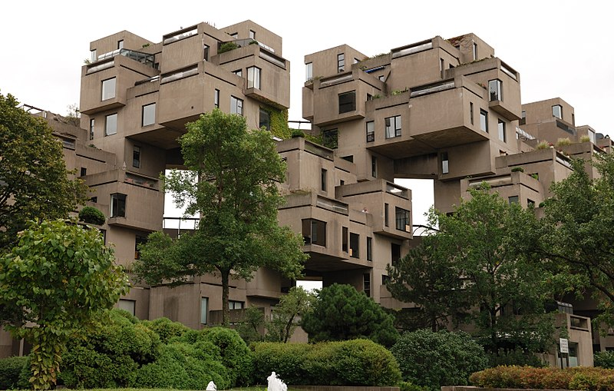

EXHIBIT 67
IN CANADA
Presented by:
Keith Dikgale
9180560005
April 30
2020

Slide 2
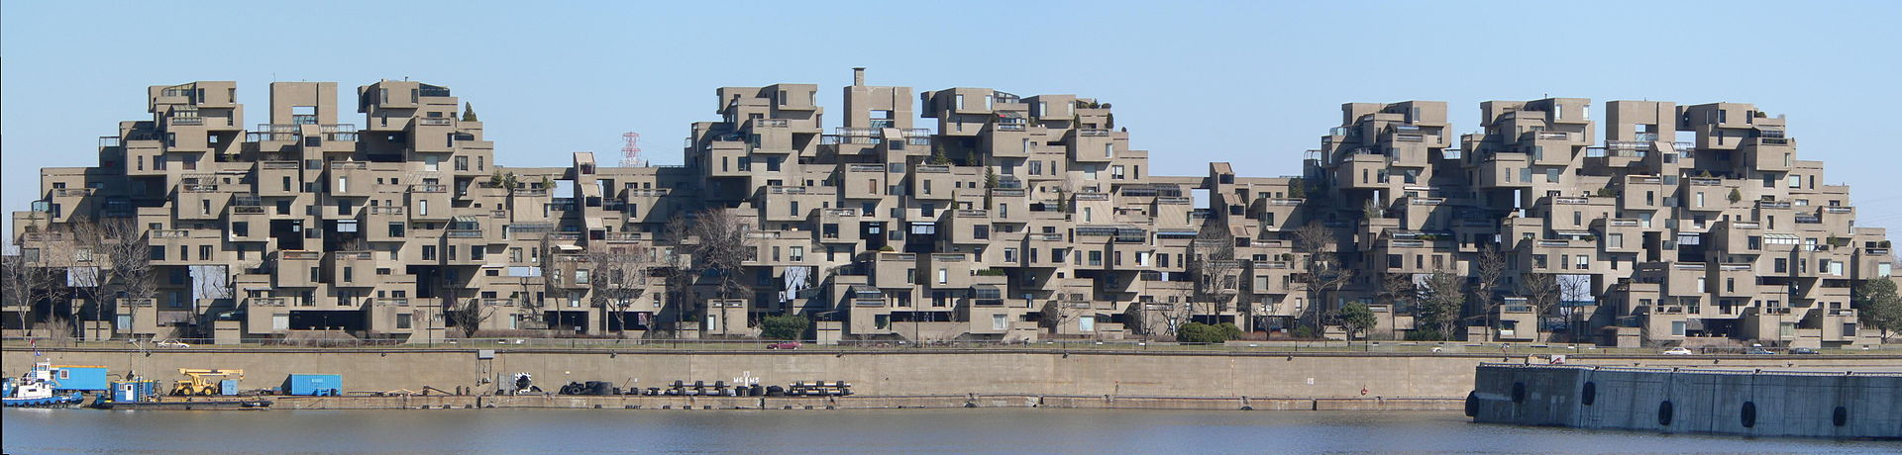
LOCATION
It is located at 2600 Avenue Pierre-Dupuy on the Marc-Drouin Quay next to the Saint Lawrence River. Habitat 67 is widely considered an architectural landmark and one of the most recognizable and spectacular buildings in both Montreal and Canada.

Slide 3
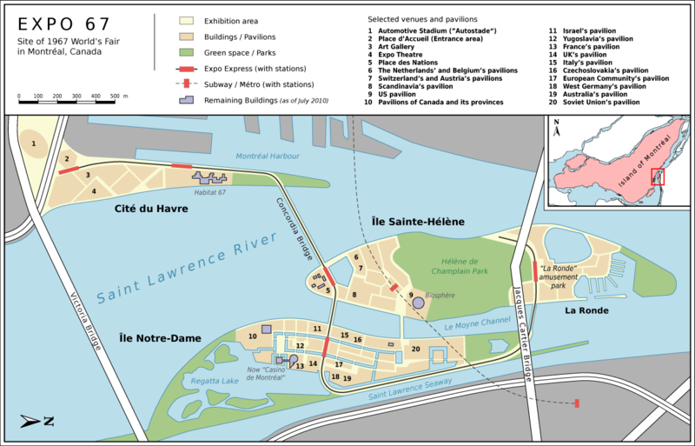
LOCATION

Slide 4
OVERVIEW
NAME | EXHIBIT 67
BUILDING | HABITAT 67
AREA | 365 hectares (900 acres)
COUNTRY | CANADA
CITY | Montreal
COORDINATES | 45°31′00″N 73°32′08″W
VENUE | Notre Dame Island Saint Helen's Island Cité du Havre
Construction started on August 13, 1963

Slide 5
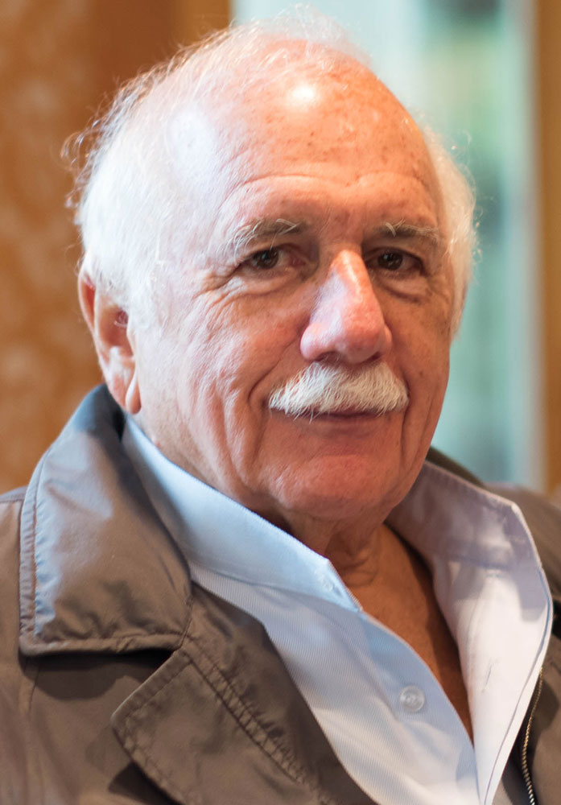
INTRODUCTION
HABITAT 67, or simply Habitat, is a model community and housing complex in Montreal, Quebec, Canada, designed by Israeli-Canadian architect Moshe Safdie. It was originally conceived as his master's thesis in architecture at McGill University and then built as a pavilion for Expo 67.

Slide 6
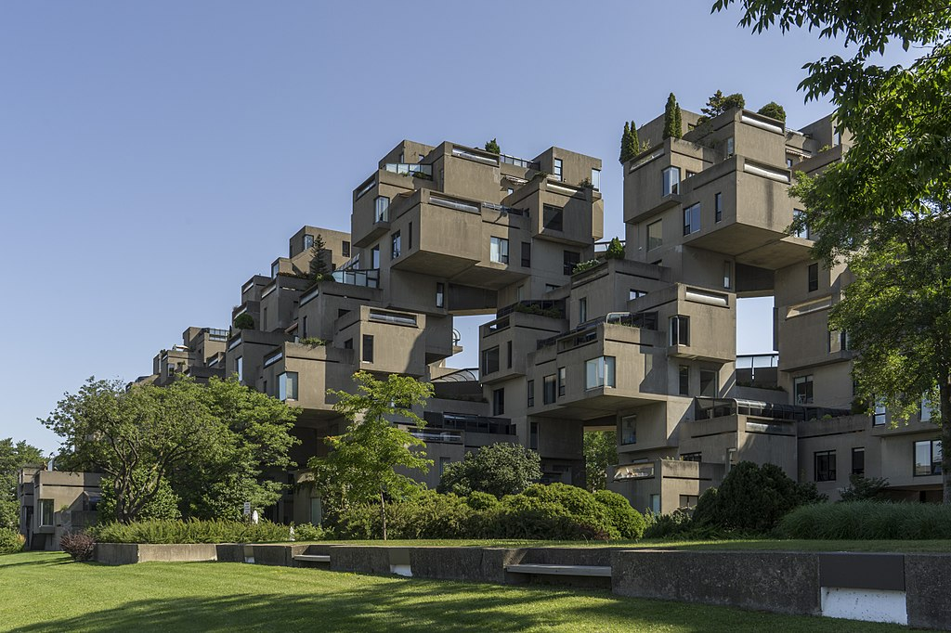
DESIGN
Habitat 67 comprises 354 identical, prefabricated concrete forms arranged in various combinations, reaching up to 12 stories in height. Together these units create 146 residences of varying sizes and configurations, each formed from one to eight linked concrete units. The complex originally contained 158 apartments, but several apartments have since been joined to create larger units, reducing the total number. Each unit is connected to at least one private terrace, which can range from approximately 20 to 90 square metres (225 to 1,000 sq ft) in size

Slide 7
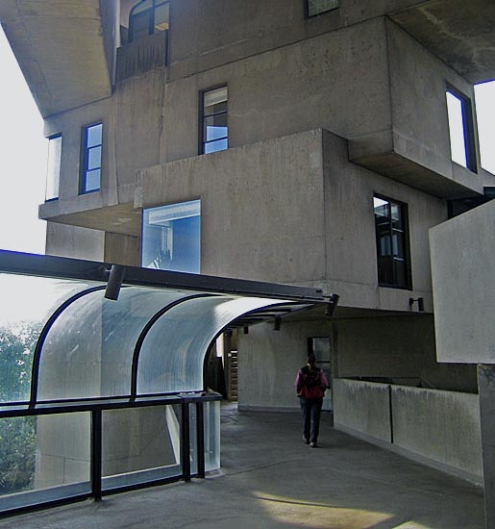
DESIGN
In Habitat ’67 all the parts of the building, including the units, the pedestrian streets, and the elevator cores, participate as load-carrying members. The units are connected to each other by post-tensioning, high-tension rods, cables, and welding, all of which combine to form a continuous suspension system. The interior components were produced, assembled and installed into each box unit in the factory, with single-unit bathrooms of gel-coated fibreglass, kitchens manufactured by Frigidaire, and window frames made of Geon plastic.

Slide 8
CONCEPT
WHY EXHIBIT 67 WAS DESIGNED
The development was designed to integrate the benefits of suburban homes—namely gardens, fresh air, privacy, and multilevelled environments—with the economics and density of a modern urban apartment building. It was believed to illustrate the new lifestyle people would live in increasingly crowded cities around the world. Safdie's goal for the project to be affordable housing largely failed: demand for the building's units has made them more expensive than originally envisioned.

Slide 9
Habitat 67 as seen from street level

Slide 10
LEGACY
As one of the major symbols of Expo 67, which was attended by over 50 million people during the 6 months it was open, Habitat 67 gained worldwide acclaim as a "fantastic experiment" and "architectural wonder". This experiment was and is regarded as both a success and failure—it "redefined urban living" and has since become "a very successful co-op", but at the same time ultimately failed to revolutionize affordable housing or launch a wave of prefabricated, modular development as Safdie had envisioned. Despite its problems, however, Habitat's fame and success "made [Safdie's] reputation" and helped launch his career; Safdie has now designed over 75 buildings and master plans around the world.

Slide 11
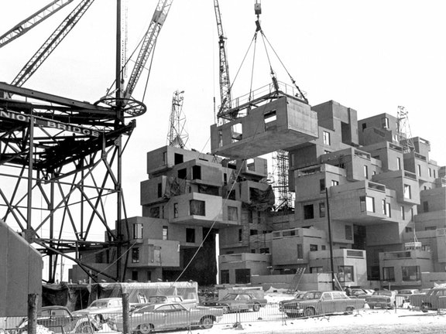
PROCESS
A factory on the site fabricated the box modules, each roughly 600 square feet in size. They were lifted and stacked by cranes and post tensioned to create the stepped form.

Slide 12
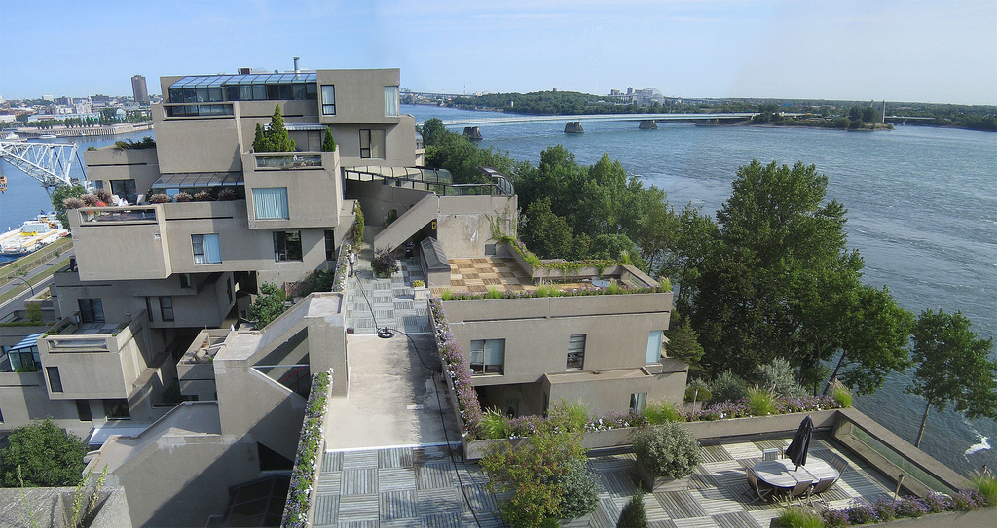
HABITAT 67
Habitat 67’s interlocking forms, connected walkways and landscaped terraces were key in achieving safdie’s goal of a private and natural environment within the limits of a dense urban space

Slide 13
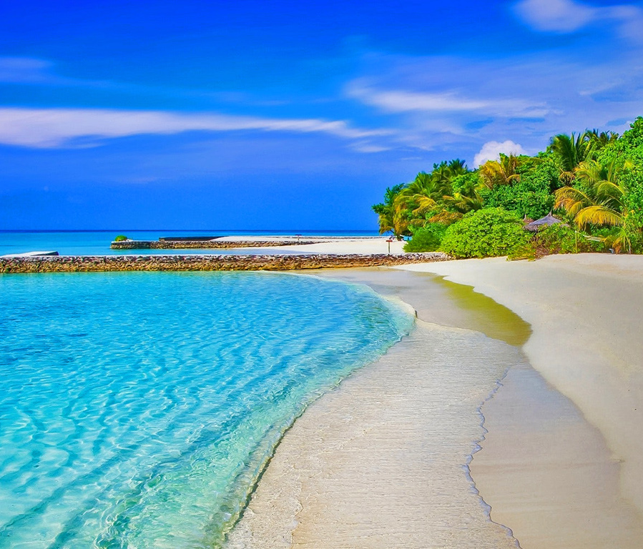
THANK YOU!
Keith Dikgale/ 9180560005
Phone:
15657112325
Email:
keithdikgale1999@gmail.com

